Slide 1
Flight Booking System
System Architecture Overview

Slide 2
System Overview
Flight Booking Application - A JavaFX desktop application
Purpose: Allows users to search for flights, manage customers, and create/manage bookings
Key Functionality:
Customer management
Flight search
Seat selection
Booking creation and management

Slide 3
Architecture: MVC Pattern
Our system follows the Model-View-Controller (MVC) pattern:
Model (Vinnsla Package): Data objects and database access classes
View (FXML Files): JavaFX UI layouts for each screen
Controller (Vidmot Package): Classes that handle user interaction and business logic

Slide 4
Model Layer
Data Classes:
Flight - Stores flight information
Customer - Manages customer data
Booking - Represents a booking with its status
Seat - Represents an individual seat on a flight
Database Classes:
FlightDB - Flight data access
CustomerDB - Customer data access
BookingDB - Booking data management
DatabaseInitializer - Sets up test data

Slide 5
Controller Layer
Domain Logic Controllers:
FlightController - Flight search and management
CustomerController - Customer lookup and management
BookingController - Core booking business logic
UI Controllers:
FlightBookerApplication - Main application controller
FlightSearchController - Flight search UI logic
CreateBookingController - Booking creation UI logic
ViewBookingController - Booking details and management

Slide 6
View Layer
Main Views:
main-view.fxml - Main application screen
flight-search-view.fxml - Flight search interface
create-booking-view.fxml - Booking creation screen
view-booking-view.fxml - Booking details view
UI Components:
List views for flights and bookings
Form controls for customer and flight data
Seat selection components

Slide 7
Database Design
SQLite Database with tables:
Customer - Customer information
Flight - Flight details and schedules
Seat - Seat inventory with booking status
Booking - Reservation records
Key Features:
Transactional operations for booking updates
Foreign key relationships for data integrity
Specialized queries for flight search

Slide 8
Data Flow: Creating a Booking
User enters his customer id
User initiates booking creation
User searches for and selects a flight
Available seats are loaded from database
User selects a seat
BookingController creates the booking
Seat status is updated in database
Booking is displayed in main view

Slide 9
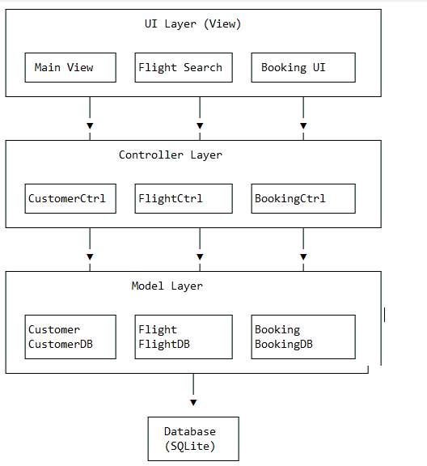
System Architecture Diagram

Slide 10
Project Retrospective

Slide 11
Problems
Hard to work on the project at the same time
Some problems with integrating code between us
Some planing issues / problems taking more time than expected

Slide 12
For the future
No matter how much you plan you can‘t plan for everything
Need to be flexible with both the planing and code
Need to be concise on problem scope

